Slide 1

RESTful - Web Services and APIs Development
Trainer igor.mitkovski@gmail.com
Assistant dejan.pblazheski@seavus.com

Slide 2
Routes and actions
ASP.NET WEB API
Matching the URI to a route template.
Selecting a controller.
Selecting an action.
Code academy @ Skopje, 2018-2019

Slide 3

Attribute routing
ASP.NET WEB API
API versioning
Overloaded URI segments
Multiple parameter types
Code academy @ Skopje, 2018-2019

Slide 4
HTTP Methods
ASP.NET WEB API
[HttpDelete]
[HttpGet]
[HttpHead]
[HttpOptions]
[HttpPatch]
[HttpPost]
[HttpPut]
Code academy @ Skopje, 2018-2019

Slide 5
Model Binding
ASP.NET WEB API
[FromQuery] - Gets values from the query string.
[FromRoute] - Gets values from route data.
[FromForm] - Gets values from posted form fields.
[FromBody] - Gets values from the request body.
[FromHeader] - Gets values from HTTP headers.
Code academy @ Skopje, 2018-2019

Slide 6
HTTP Codes
ASP.NET WEB API
100 group: Items in progress.
200 group: Successful responses.
300 group: Redirects, which tell the browser to look someplace else.
400 group: Browser errors, also called client errors.
500 group: Server errors.
https://developer.mozilla.org/en-US/docs/Web/HTTP/Status
Code academy @ Skopje, 2018-2019

Slide 7
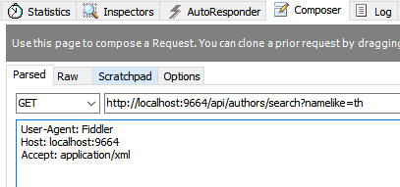
Content negotiation
ASP.NET WEB API
Content negotiation (conneg for short) occurs when the client specifies an Accept header.
The default format used is JSON.
Code academy @ Skopje, 2018-2019

Slide 8
?
ASP.NET WEB API
Code academy @ Skopje, 2018-2019

